Slide 1
(WP2) Characterization of Novel Materials for APDs
PROMIS Workshop 2, Cadiz
Shumithira Gandan

Slide 2
Avalanche Photodiodes
Avalanche multiplication in APDs allow use in applications requiring high sensitivity levels.
Security applications of APDs– LIDAR and X-ray spectroscopy
nm wide avalanche region allows exploitation of ‘dead space’ effects(w <50nm)
Dead space – distance required by carrier to acquire sufficient energy to impact ionize

Slide 3
Novel Materials
Combining InGaAs with nanoscale AlAsSb is expected to improve soft X-ray detection especially for X-ray imaging arrays
Benefits for low photon sensing applications:
Lower excess noise performance
Comparable to Si APDs but at IR wavelengths >1100nm, k <0.2
High immunity to temperature fluctuation
Two orders of magnitude reduction compared to ~100mV/K in typical InGaAs/InP SPAD
Higher sensitivity with shallow pixels
Thickness of >20um in Si makes fabricating high format imaging arrays difficult.
InGaAs and nm avalanche region -> high sensitivity with <6um shallow pixels
Cadiz Workshop

Slide 4
Time-resolved Photoluminescence
Allows measurements of transition energies and lifetimes of carriers
ns and ps resolution possible with the use of a streak camera
Intensity of emission α number of photo-generated carriers
Decay times reflect recombination rates and reveals quality of crystalline structure
Presence of impurities and defects significantly reduce decay times

Slide 5
Streak image
Warmer colours correlate to higher photon counts
Wavelength(nm)
Time(ps)

Slide 6
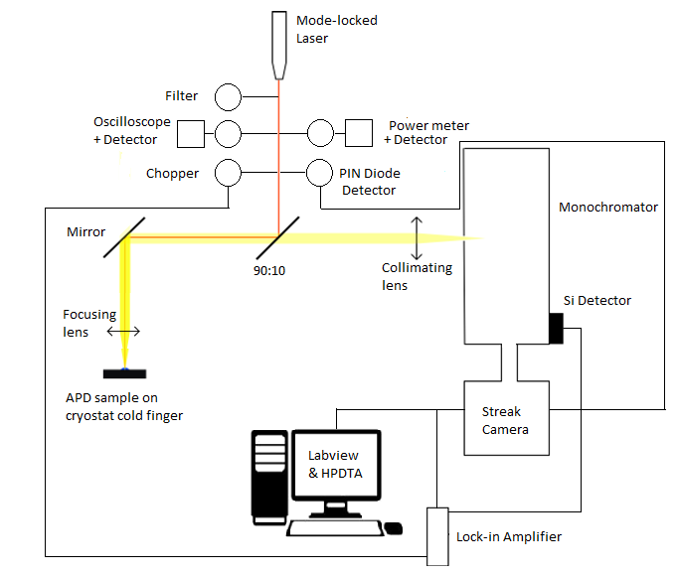
Schematic of PL & TRPL Setup

Slide 7
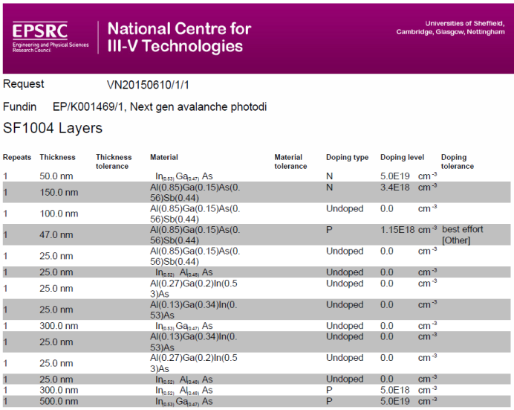
AlGaAsSb Avalanche layer

Slide 8
AlGaAsSb PL

Slide 9
AlGaAsSb TRPL

Slide 10
InAlAs PL

Slide 11
InAlAs TRPL

Slide 12
Semi-metallic InGaAs layer prevents complete penetration of light into APD layers
New samples with InGaAs etched and covered with photoresist was received
After removal of p.r layer, samples need to be placed in vacuum conditions immediately to prevent oxidation of high Al content in the samples

Slide 13
Latest Results : AlGaAsSb

Slide 15
Latest Results : InAlAs

Slide 17
Plan for next 6 months
Match the PL spectra with bandgap structure modelled for each layer for both samples
Vary the excitation wavelength with a tunable laser to change the penetration depth of light into the structure
Obtain time-resolved spectra for all the emission peaks of each sample

